Slide 1
Research Methods or Research Designs
COURSE: RESEARCH METHODOLOGY and SCIENTIFIC WRITING
STUDY PROGRAM: INFORMATION SYSTEMS, COMPUTER SCIENCE FACULTY, UNIVERSITY OF INDONESIA, September 2019
Disampaikan oleh:
Tim Pengajar MPPI

Slide 2
Agenda
1. Method versus Methodology
2. Types of Research Methods
3. Experimental Research
4. Causal – Comparative Research
5. Correlational Research
6. Survey Research
7. Action Research
8. Historical Research
9. Ethnographic Research
10. Case Studies Research

Slide 3
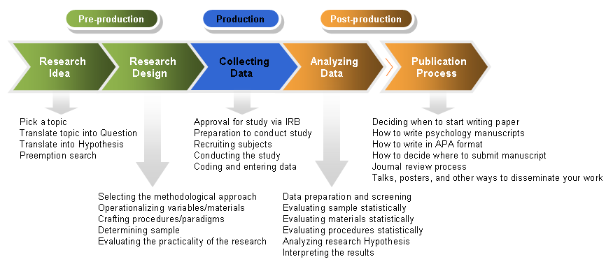
Research Design in Perspective…
Source: http://dandelion-films.com/research-design

Slide 4
Research Design
Selecting the methodological approach
Operationalizing of variables
Crafting procedures/paradigm
Determining sample or unit analysis
Evaluating the practicality or the feasibility of the research (do-able or not at the given time, budget, etc.)

Slide 5
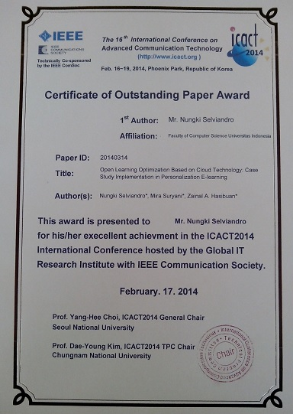
Salah satu bentuk penghargaan terhadap para penulis dari
Lab DL2 Fasilkom, UI.

Slide 6
1. Method or Methodology?
Research Methods are the techniques/ procedures used to collect and analyse data. Sometimes they called Research Designs
Methodology refers to discussions of how research is done, or should be done, and the critical analysis of methods of research
Conceptual frameworks and assumptions used to inform research
Elaboration of research method
The paradigm that dictates which methods are used, and how they are applied and arranged.
This distinction is not clear cut, even in established literature!
However, the debate should focus on how the method or the methodology solve the issues or problems of the research
(Blaike, 2000:8)

Slide 7
When, where, and how..?
Kapan anda harus menggunakan metode penelitian atau metodologi penelitian?
Dimana atau dalam konteks apa anda menggunakan metode penelitian atau metodologi penelitian.
Bagaimana anda menerapkan metode penelitian atau metodologi penelitian.
Rule of thumb: if the research issue is so straight forward, use method, but
the research issue is complex then use methodology. Berikan contoh2nya.

Slide 8


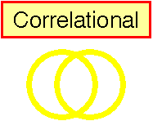


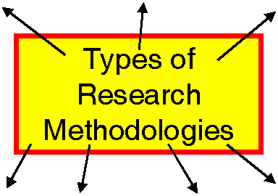








2. Types of Research Methods that Research Methodology Can Be Build Upon
Case Study

Slide 9
Research Methods
Research method or research design can be used in conducting research.
Research method can be part of research methodology.
Research method can be qualitative and or qualitative in nature.
Berikan contoh2 research method yang “nature-nya” kuantitatif dan kualitatif.

Slide 10
Example of Research Design (Source: Hasibuan and Dantes, 2011)
?
Organization Maturity Level is the score of the role of information system (IS) in a company.
Implementation Approach is the score of the approach adopted in ERP implementation in a company.
ERP Implementation Success is the score for the success or lack of success in its implementation in a company.
Competitive Advantage is the score of benefit that company has through ERP implementation

Slide 11
Categories of Research Method
By purpose:
Basic/fundamental/pure research
Applied research
By time:
Cross-sectional (A cross-sectional study is an observational one)
Longitudinal (researchers conduct several observations of the same subjects over a period of time, sometimes lasting many years)
By methodology:
Quantitative vs. Qualitative
Exploratory vs. Experimental

Slide 12
3. Experimental Research
Experimental Research
Research that allows for the causes of behavior to be determined
Experiment
A carefully regulated procedure where one or more factors are manipulated and all other factors are held constant
Cause-effect relationship occurs if:
The cause is correlated w/ the effect.
The cause occurred before the effect.
We can rule out other plausible explanations of the causal relationship
Example: Learning effectiveness between with and without e-learning system. Give more examples of experimental research!

Slide 13
Factors in Experimental Research
Independent Variable (IV)
Factor that is manipulated (hasil pengukuran-nilai variable, berbeda-beda)
Dependent Variable (DV)
Factor that is measured (ditentukan dari hasil pengolahan IV)
Experimental Condition (group)
A group that is manipulated during the experiment (kelompok yang dikenakan perlakuan, sehingga nilai variablenya IV bervariasi.
Control condition (group)
Comparison group that is not manipulated (kelompok tanpa perlakuan
Confounding variable
An uncontrolled variable that is unintentionally allowed to vary systematically with the independent variable.
Notes:
Tutoring vs. lecture example
I.V. method of teaching used
DV: posttest score
Experimental Condition: condition that is manipulated, that is the tutoring condition
Control Condition: Here it is the lecture condition
Confounding variables: tutoring requires active participation, whereas a lecture may not & tutoring involves dialog, whereas most of lecturing is a monolog given by the professor
2nd example: interested in the effect of laughter during an exam on a student’s blood pressure
IV: presence of jokes, cartoons, whatever funny material to illicit laughter
DV: blood pressure
Exper. Condition: test takers who receive funny material used to illicit laughter
Control Condition: regular test taking situation
Confounding variable:
Different senses of humor, the jokes or material that was supposed to illicit humor may not be funny at all, thus the IV really may not be causing the manipulation that we think we are testing.
3rd example: Hours of time spent studying stats effect on stats quiz/test
Imagine, I randomly assigned each of you to either study like you normally would or to study for 3 hours or to study for 6 hours
What is the IV? Hours studied, DV? Score on the quiz, Experimental group: the ones I assigned, Control group: ones I left alone, Confounding variable: overall GPA

Slide 14
Isu-2 Yang Mungkin Menggunakan Experimental Research dalam IS/IT
Sejauh mana penggunaan TIK dapat meningkatkan kualitas PBM?
Sejauh mana social media dapat meningkatkan efektivitas komunikasi?
Sejuah mana Sistem Informasi dapat meningkatkan daya saing UMKM?
Berikan contoh2 lain, kemungkinan menggunakan experiment research. Sebutkan mana yang variable independent-nya, mana variable dependent-nya

Slide 15
Quasi-experimental research
Quasi-experimental research
Almost but not quite real experiments
No manipulation of the variables (so no IV)
Compare groups biased on naturally occuring variables
Two types of natural variables
Subject variable. Characteristics that vary between participants, but can not be manipulated
Time variable
Comparing individuals at different points in time (age 3 and 6)
One-shot posttest, no control group
Example: The impact of marketing strategy.
Notes:
It is not always possible (or ethical) to manipulate a condition in order to study its effects.
E.g. can’t assign a group to schizophrenia
Can’t manipulate the variables because they are already naturally manipulated
Subject variables: Age, gender, IQ, school or school system attended

Slide 16
Contoh-2 Quasi-Experiment dalam Research IS/IT
Sejauh mana pengaruh Q/A system terhadap kualitas layanan TIK perusahaan.
Sejauh mana pengaruh e-learning terhadap kualitas pendidikan.
Sejauh mana pengaruh CRM terhadap kepuasan pelanggan.
Sejauh mana pengaruh SCM terhadap peningkatan kinerja perusahaan.
Contoh lain?

Slide 17
4. Causal – Comparative Research
Ex Post Facto = Causal-Comparative Research
Explores possible causes and effects
The independent variable is not manipulated, it has already been applied
Focuses first on the effect, then attempts to determine what caused the observed effect.
Seeks to explain differences between two groups that have occurred

Slide 18
Contoh2 Comparative Study di Bidang IS/IT
Perbandingan IT multinational companies dengan IT national companies.
Perbandingan peringkat e-government dari berbagai negara.
Perbandingan tingkat kematangan e-business di berbagai negara.
Perbandingan tingkat e-readiness di berbagai negara.
Contoh lain?

Slide 19
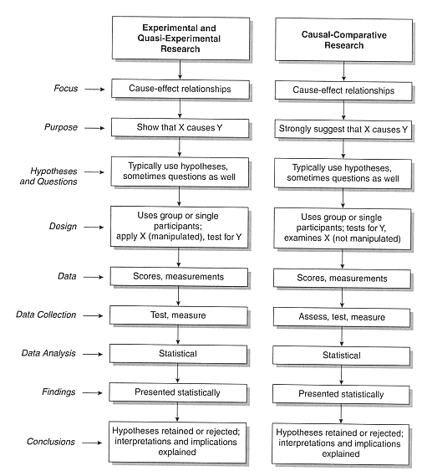
Bandingkan karakteristik kedua research design tersebut!

Slide 20
5. Correlational Research
Measure two variables
Study methods and grade-point average
Determine degree of relationship between them
Correlation coefficient (e.g., r = 0.50)
Allows description and prediction of the relationship
Unlike experiment, no attempts to control variables

Slide 21
Contoh Correlation Research
Faktor-2 apa saja yang berpengaruh terhadap peningkatan efisiensi dan efektivitas suatu perusahaan.
Faktor-2 apa saja yang menentukan sukses atau gagalnya pengembangan suatu sistem informasi.
Faktor-faktor apa saja yang mendorong seseorang menggunakan TIK.
Contoh lain?

Slide 22
6. Survey Research
The survey is a group of research methods commonly used to determine the present status of a given phenomenon
A survey is a systematic method of collecting primary data based on a sample
Survey may be used for exploratory, descriptive and causal studies
Unlike case study, the purpose of a survey is not to consider a specific case in depth but to capture the main characteristics of the population at any instant
For example: We want to explore the opinion of top executives on IT Manager
Powell, 1999

Slide 23
Survey Research
Collecting standardized information from people using an interview or self-report format.
Typically survey knowledge or opinions.
To standardized the information one uses a questionnaire with set questions.
Ideally the questionnaire has been validated.
Representativeness of the sample is very important.

Slide 24
Survey Methods
Interviews
Advantage - Comprehensive, ensure participant understands the question, minimizes missing data, enables clarification of unclear responses
Disadvantage – expensive, people more like to refuse participation, can be risky for interviewer, interviewer may bias the responses.

Slide 25
Types of Survey Methods
Face-to-face interviews
Expensive and time-consuming
Telephone interviews
Need to use random-digit dialing to reach both listed and unlisted numbers.
Mail
Return rate is usually low (20-30%).

Slide 26
Types of Questions
Open-ended
E.g., Can you tell me about your typical experience with dating?
Close-ended
E.g., How do you typically meet someone to date?
Introduced by someone
Social event
In university class or place of work
At a bar
Through sports or other athletic events
Notes:
Open-ended questions are valuable when you want to know what the person is thinking or when the dimensions of the variable are not well defined. Disadvantage to the open-ended question is that the responses must be coded, takes time, and open to interpreter bias.
Watch out for ambiguous or leading questions or double-barreled questions.

Slide 27
7. Action Research
"Action research is a form of collective self-reflective enquiry undertaken by participants in social situations in order to improve on the rationality and justice of their own social or educational practices, as well as their understanding of their own social or educational practices and the situations in which these practices are carried out.
Groups of participants can be teachers, students, principals, parents and other community members, - any group with a shared concern.
The approach is only action research when it is collaborative, though it is important to realize that the action research of the group is achieved through the critically examined action of individual group members."
Kemmis, Stephen & Robin McTaggart (eds) The Action Research Planner, 3rd edition, Victoria: Deakin University Press, 1988.

Slide 28
Action Research
Joint Application Development
Business model suatu perusahaan

Slide 29
7. Historical Research
The conduct of historical research entails the following steps:
The recognition of a historical research problem or the identification of a need for certain historical knowledge
The gathering of as much pertinent information about the problem or topic as possible
If appropriate, the forming of hypotheses that tentatively explain relationships between historical factors (variables)
The selection, organization, and analysis of conclusion
The recording of conclusions in a meaningful narrative
Busha, Charles H.1980

Slide 30
The Four Steps in The methodology of Historical Reserach
Identification of the research problem
(Formulation of Hypotheses and Questions)
Collection and Evaluation of source Materials
External and internal Criticism
Analysis Interpretation Formulation of Conclusions
(Hypotheses Supported or Rejected)
Synthesis of information from source Materials
Possible Continued Formulation of Hypotheses and questions
Possible Hypothesis Revision
Wiersma, 1986

Slide 31
Contoh Historical Research
Critical review perkembangan Sistem Informasi dari tahun 1960-2015

Slide 32
9. Ethnographic Research
Ethnographic research involves field research and requires contextualization - the interpretation of result in the data collection.
Ethnographic studies focus on organizations, which consist of defined groups of people who interact in regular and structured ways.

Slide 33
Typical Ethnographic Studies in Education:
A study of life in urban classroom
A study of decision making in an inner-city high school
A study of student life in law school
A study of student relations in an integrated school
A study of peer interaction in racially mixed classroom of a suburban high school

Slide 34
The Process of Ethnographic Research
Identification of the phenomenon to be studied
Identification of subjects
Hypothesis generation
Data Collection
Observation
Interview
Reviewing Other sources
Triangulation
Analysis of Data
Drawing Conclusion

Slide 35
Contoh Ethnographic Research
Bagaimana suku anak dalam beradaptasi terhadap TIK

Slide 36
10. Case Studies Research
Empirical investigation of particular phenomenon
A ‘case’ may be an organization, community, country, etc
Boundary problems should be determined
Multiple cases are suggested to compare and contrast different cases
Should be holistics and robust
Use qualitative and quantitative data
Guided by a hyphothesis. “To examined why a particular company success or fail in using IT”

Slide 37
Contoh: Case Studies Research
Penggunaan TIK yang komprehensif pada perusahaan XYZ.
In-depth analysis must be applied to the case.
The research issues must be significant and based on existing problem to perusahaan XYZ.
The research results can not be extrapolated beyond perusahaan XYZ.

Slide 38
Shifting Paradigm Research on IS/IT
During the ’70s and ’80s, IS/IT research was predominantly technical.
With newfound maturity (’90s, ’00s), more focus on social issues:
Productivity, efficiency
Usability, acceptance, user satisfaction
How valid is IS research based on methods taken from social sciences? (Potentially,) very!

Slide 39
Research on IS/IT:
Which method should be used? Which methodology should be used?

Slide 40
Question?
TIP
If you do not understand something
ask me!

